Slide 1
XYZ Corporation Lending Data Project
Submitted By:
Hemalathaa.A.E (IL014563)
Course and Batch : DSP-21 Chennai September 2019

Slide 2
Objective
The main objective is to predict the probability of default, whether the customer will default the loan or not by using the past data.
That means, given a set of new predictor variables, we need to predict the target variable as 1 -> Defaulter or 0 -> Non-Defaulter.
Dataset Description: Contains 855969 rows and 73 columns

Slide 3
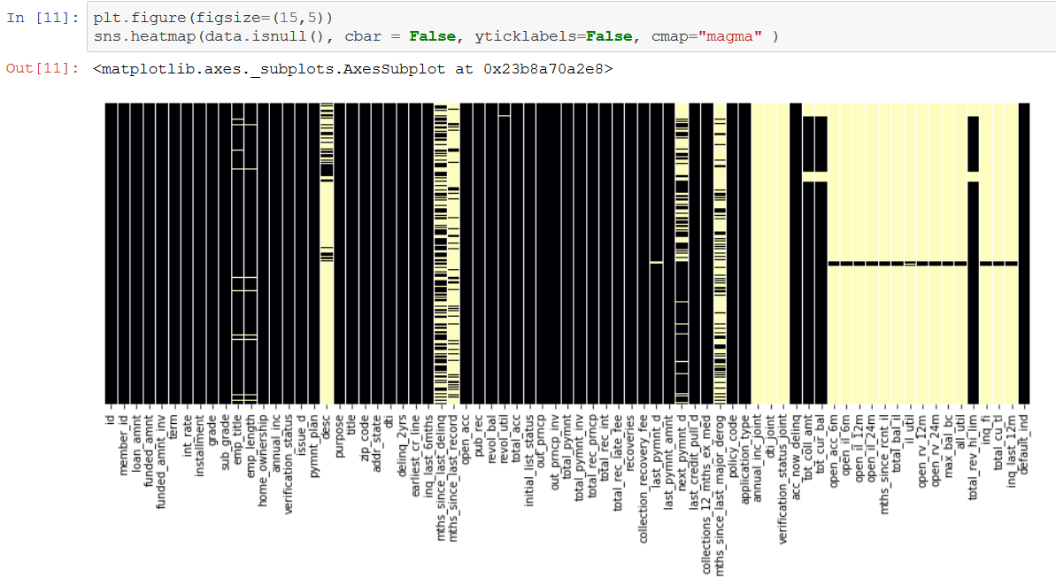
Phase I – Data Extraction and Cleaning:
Missing Value Analysis and Treatment –
Using heatmap we could visualize that our dataset contains a lot of missing values.

Slide 4
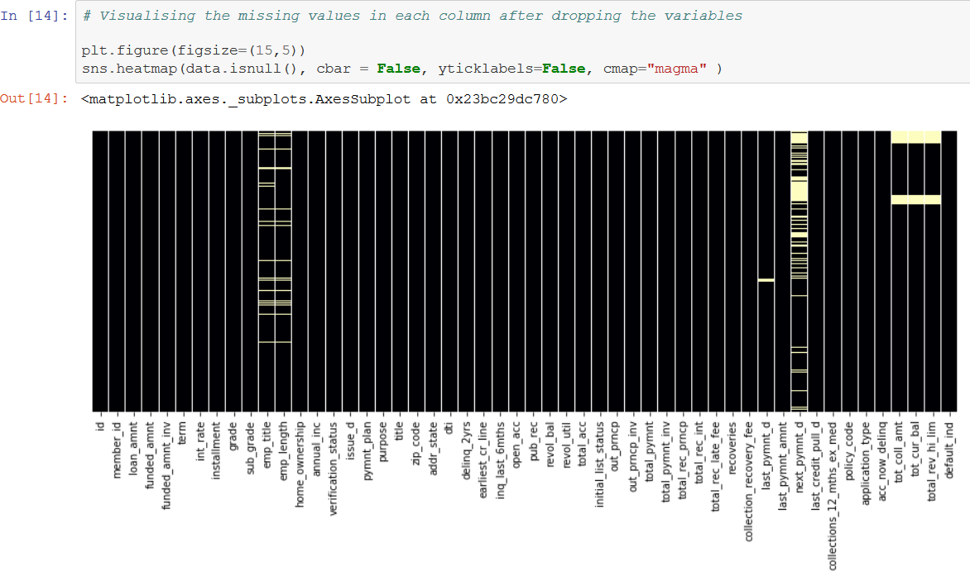
Phase I – Data Extraction and Cleaning:
After dropping the columns we can visualize our dataset much better with total 52 variables left by setting a threshold of 50%.

Slide 5
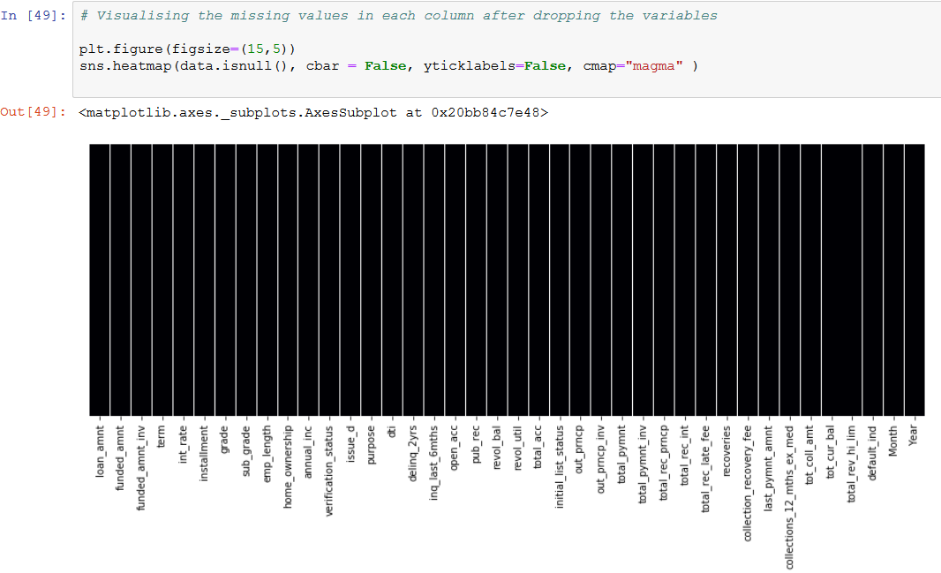
Phase I – Data Extraction and Cleaning:
Also the dataset does not consists any duplicate records.
Then all the irrelevant variables are dropped with proper reasoning and we’re left with 36 variables.
The following heat map visualizes the dataset after treating the remaining missing values with mean and mode.

Slide 6
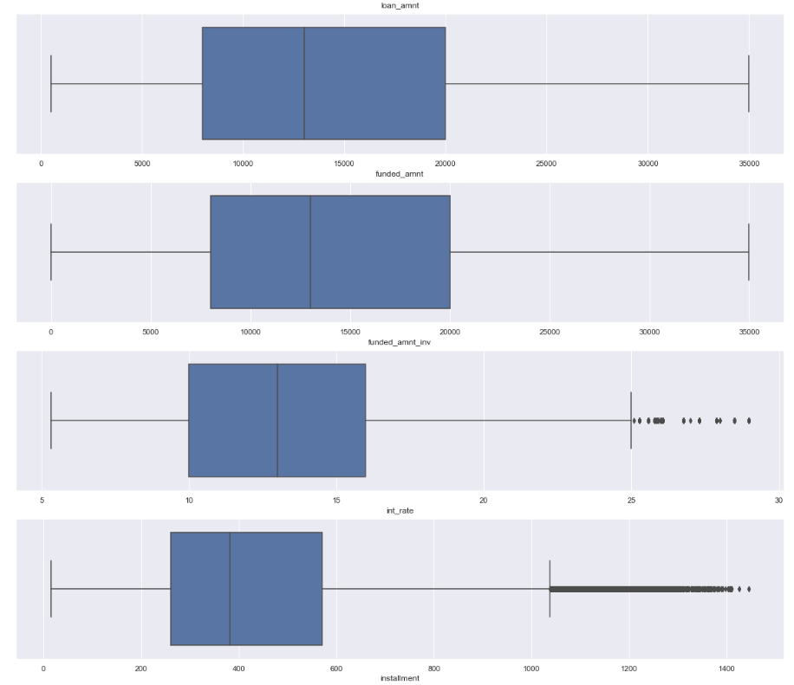
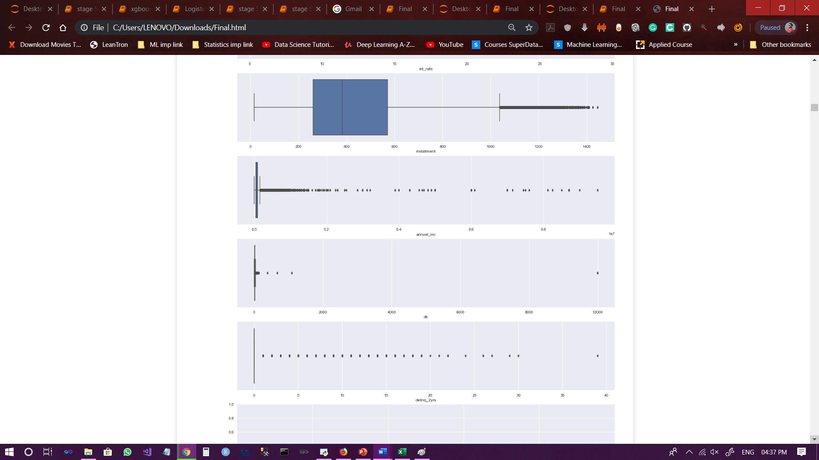
Exploratory Data Analysis:
No outlier Treatment.

Slide 7
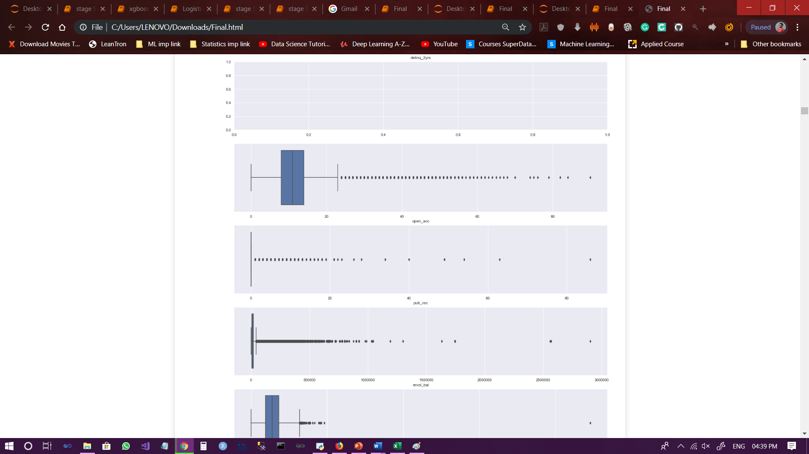
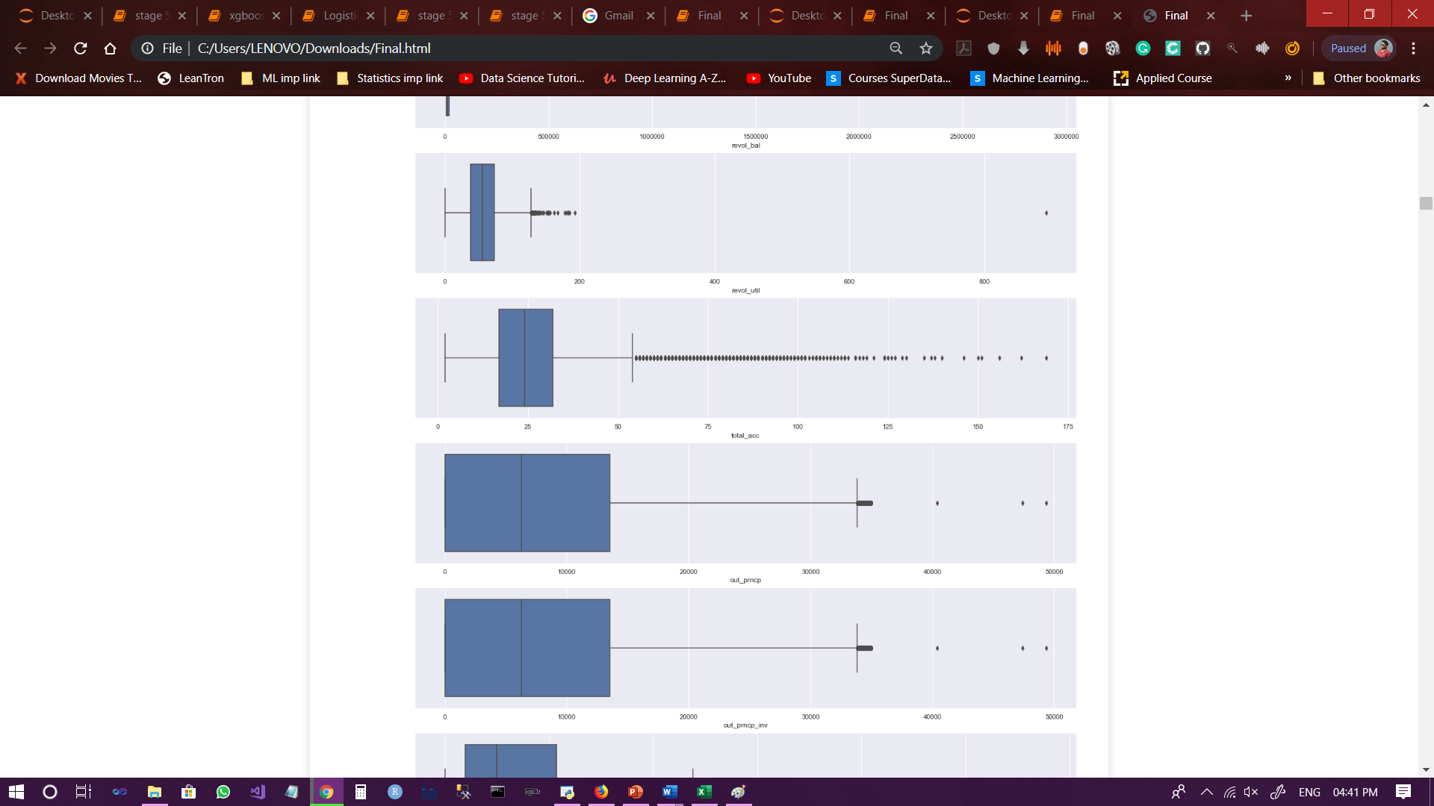
Exploratory Data Analysis:

Slide 8
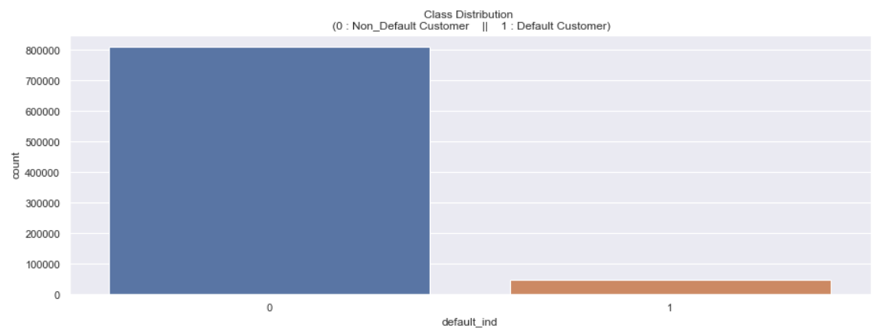
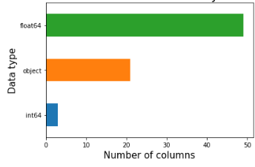
Exploratory Data Analysis:
Plot showing the count of the Default
customers and Non-default customers in ‘default_ind’ variable.
Number of columns distributed by Data Types

Slide 9
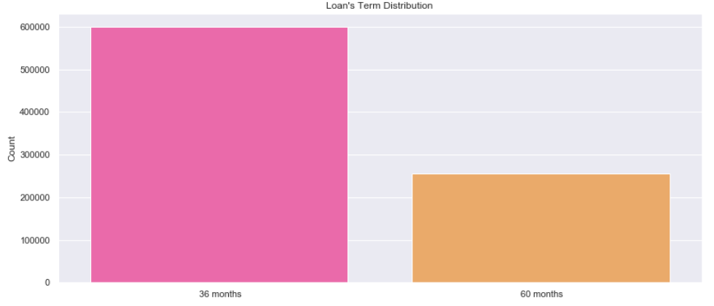
Exploratory Data Analysis:
Plot showing the distribution of ‘term’ variable.

Slide 10
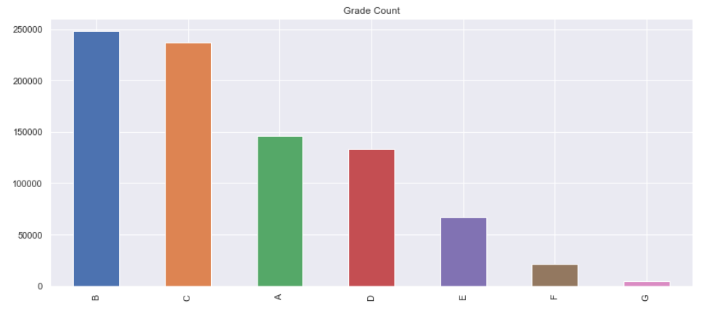
Exploratory Data Analysis:
Plot showing the Grade Count.

Slide 11
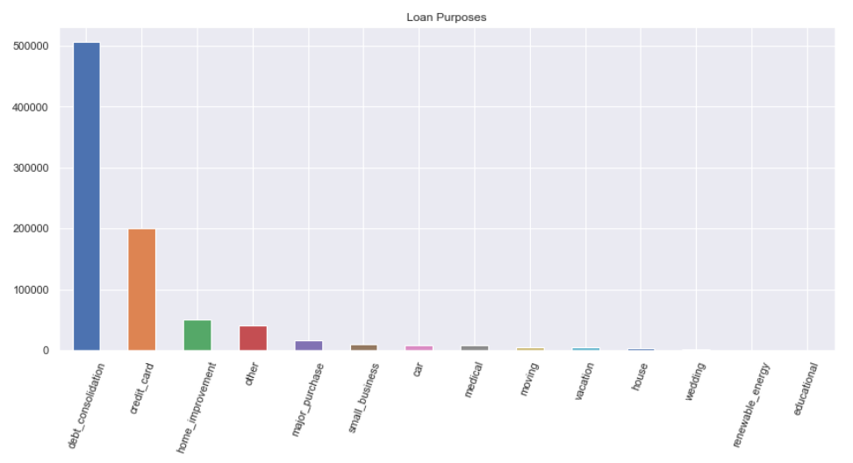
Exploratory Data Analysis:
Plot showing the purpose for which the loan was taken by every individual.

Slide 12
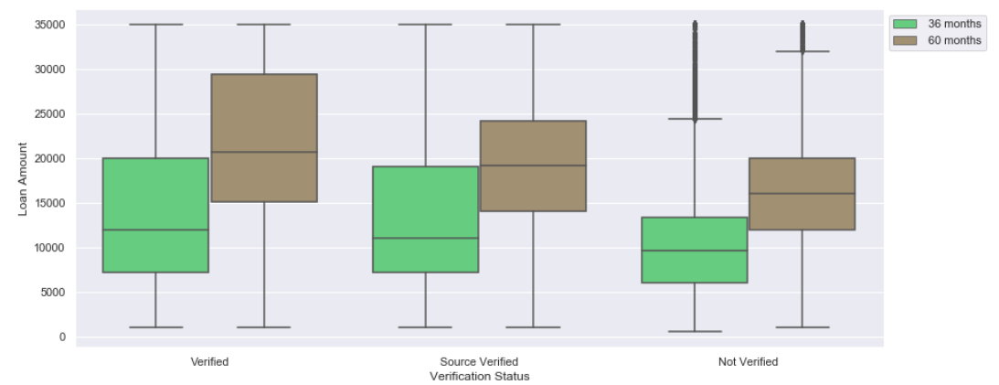
Exploratory Data Analysis:
Plot showing Loan amount by verification status.

Slide 13
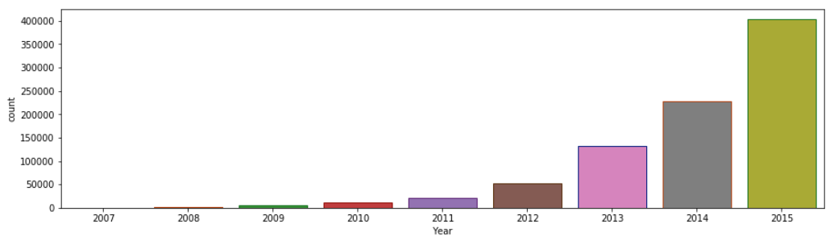
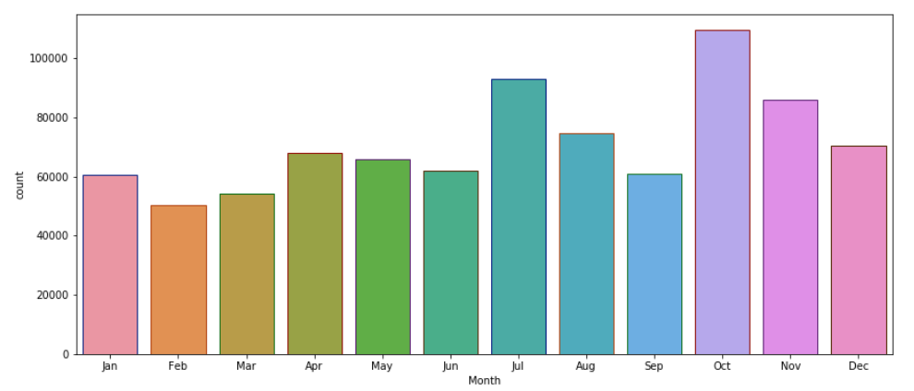
Exploratory Data Analysis:
Plot showing the issue date in year and month of the loan amount.

Slide 14
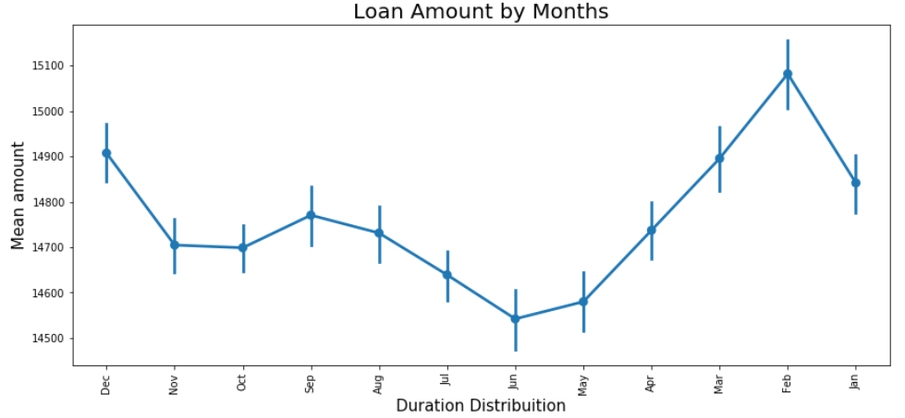
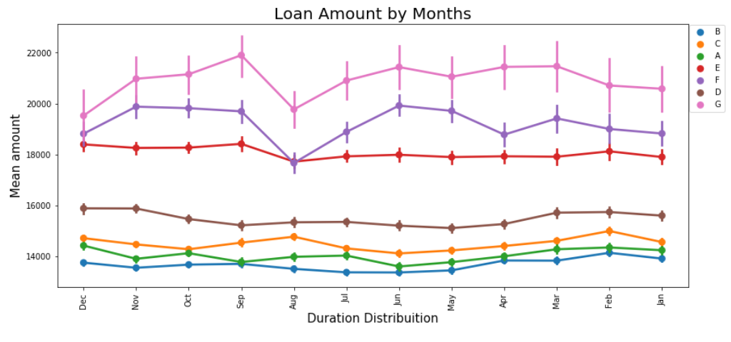
Exploratory Data Analysis:
Left graph showing loan amount by months.
Right graph showing loan amount by months and grade.

Slide 15
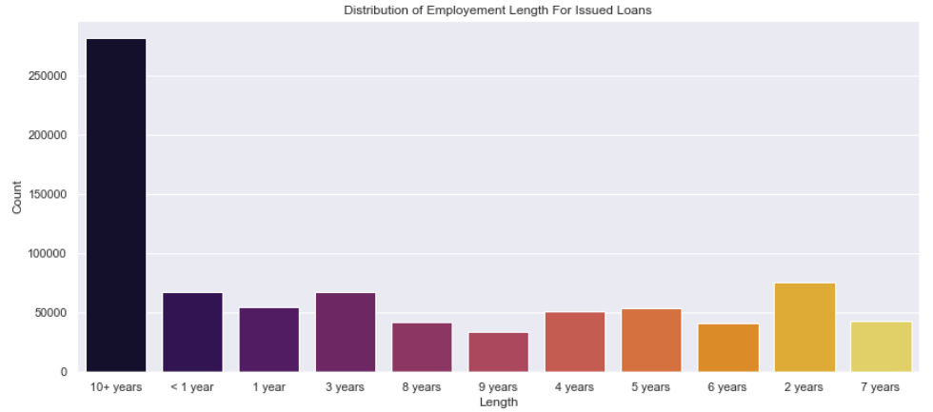
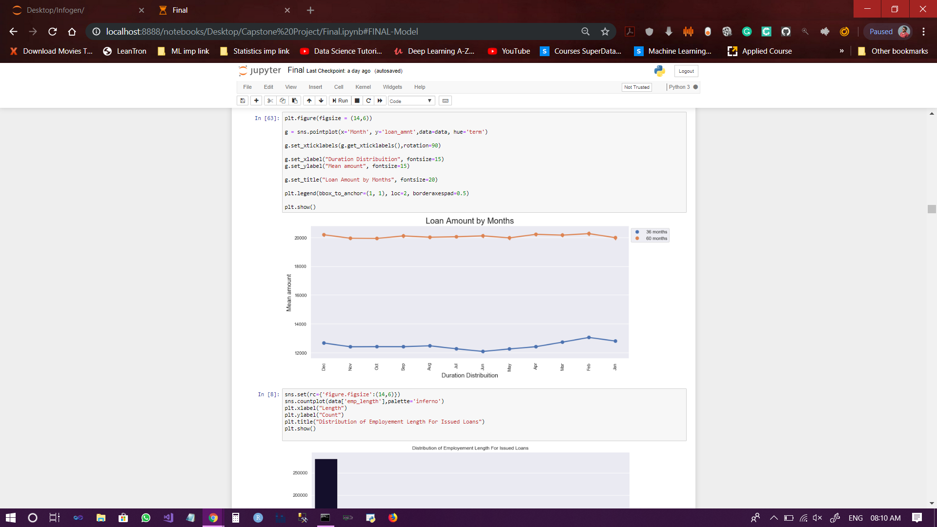
Exploratory Data Analysis:
Plot showing Loan Amount by Months
Plot showing distribution of length of employment in years for the issued loans.

Slide 16
Data Processing:
Different ways to convert categorical variables to numbers-
Dummy Variable
Label Encoding
Manual Encoding

Slide 17
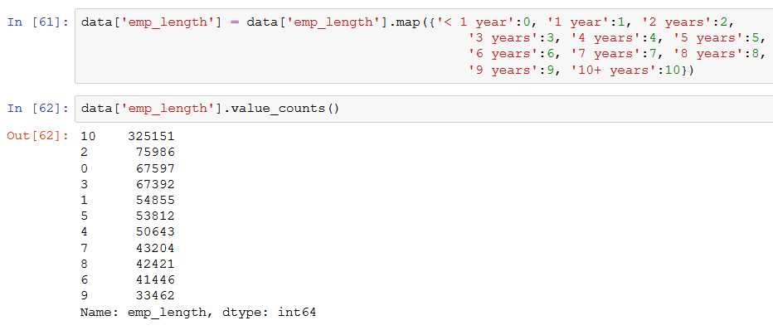
Data Processing:
Manual Encoding-
just like employee length, we performed manual encoding or other variables like the term, initial status, verification status, home ownership and grade.

Slide 18
Fitting Models to Data:
Data Partition-
Data is divided on ‘issue_d’ variable.
Records from June-2007 to May-2015 in Training data.
Records from June-2015 to Dec-2015 in Testing data.
Followed by dropping the irrelevant columns such as ‘issue_d’, ‘str_split’, ‘m’ and ‘y’, we are left with 36 variables.
598978,36 is the shape of Train data.
256991,36 is the shape of Test data.
Feature Scaling-

Slide 19
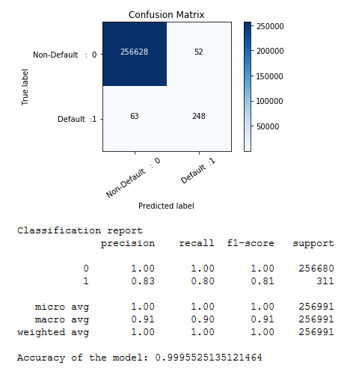
Fitting Models to Data:
LOGISTIC REGRESSION-

Slide 20
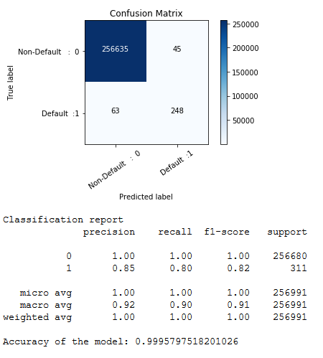
Fitting Models to Data:
TUNING THE MODEL-
Adjusting the threshold level of the probabilities to 0.60:

Slide 21
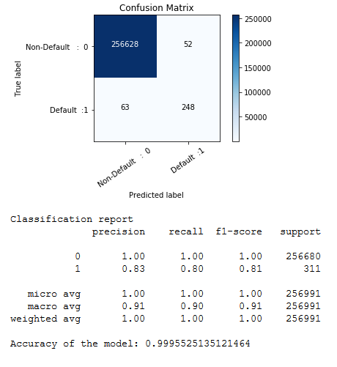
Fitting Models to Data:
Using CROSS VALIDATION-

Slide 22
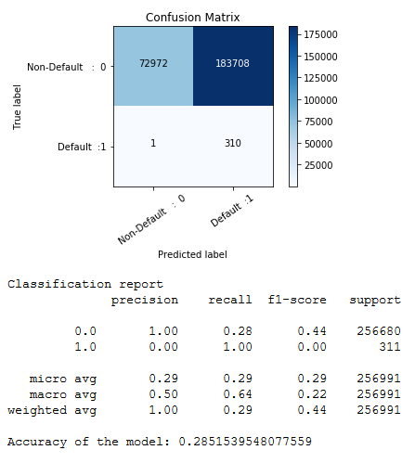
Fitting Models to Data:
DECISION TREE CLASSIFICATION-

Slide 23
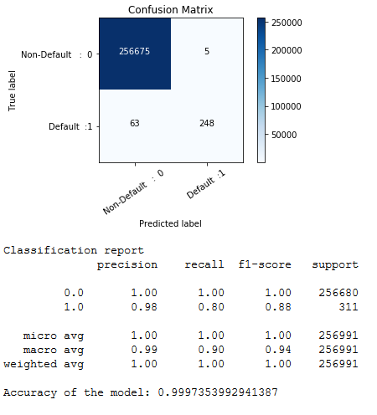
Fitting Models to Data:
ARTIFICIAL NEURAL NETWORK(ANN)-
Deep Learning on Unbalanced Dataset.

Slide 24
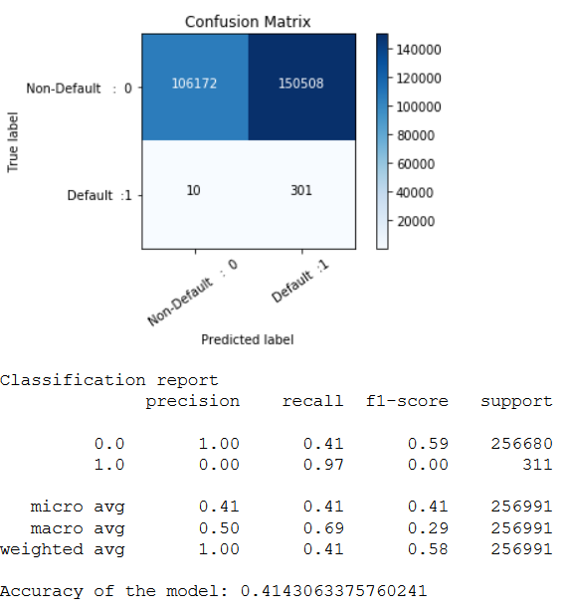
Fitting Models to Data:
Deep Learning on Balanced Dataset using Smote Function.

Slide 25
Feature Selection
Creating another dataframe with new variables.
Previously we had 36 variables.
In new dataset we added total 41 variables.

Slide 26
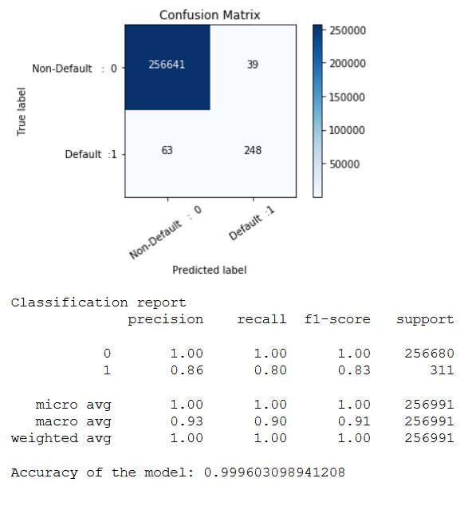
Fitting Models to Data:
Logistic Regression on New Dataset.

Slide 27
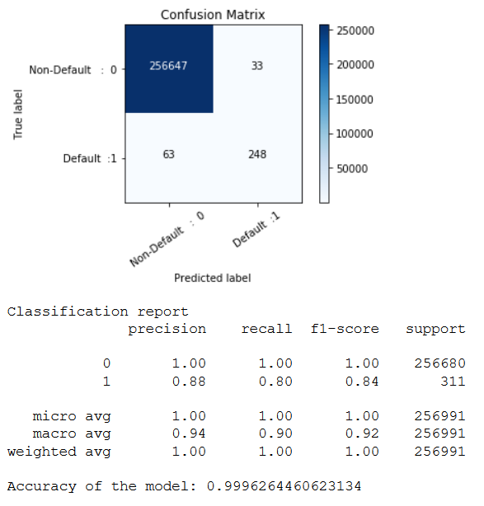
Fitting Models to Data:
After Tuning the Model.

Slide 28
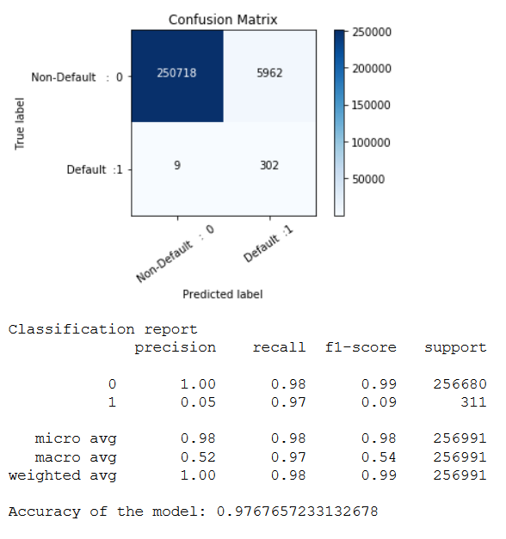
Fitting Models to Data:
Decision Tree Classification on New Dataset.

Slide 29
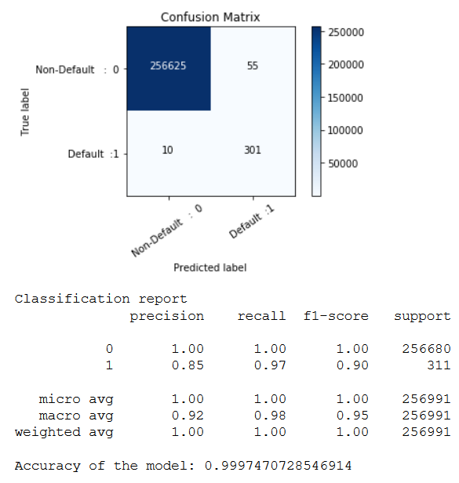
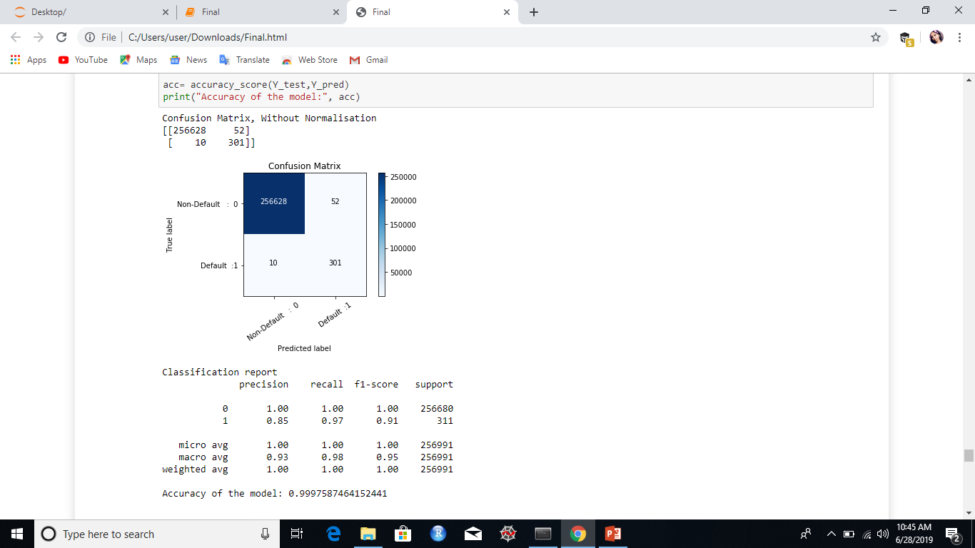
Fitting Models to Data:
Gradient Boosting Classifier.
BEFORE TUNING: AFTER TUNING:

Slide 30
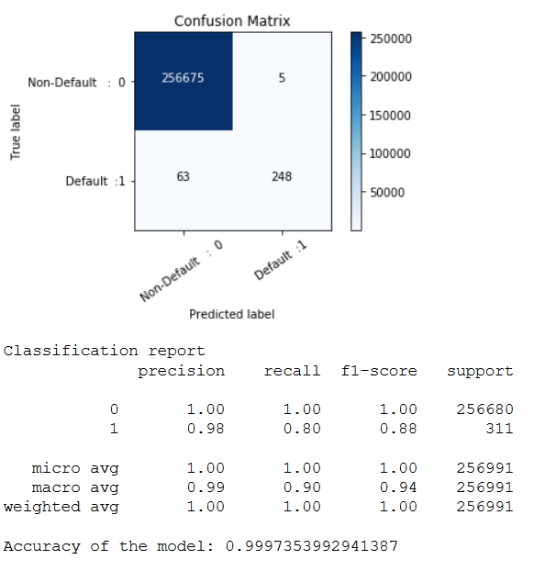
Fitting Models to Data:
ANN on the New Dataset. (On Unbalanced Data)

Slide 31
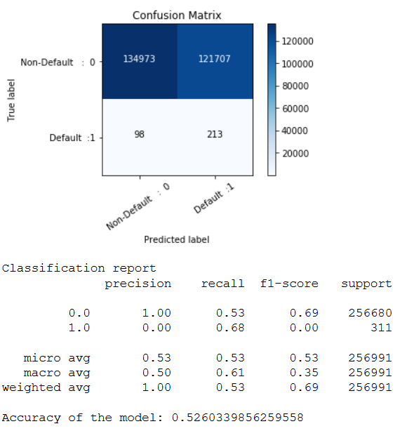
Fitting Models to Data:
ANN on the New Dataset. (On Balanced Data)

Slide 32
Final Model:
Gradient Boosting Classifier. (With Tuning)

Slide 33
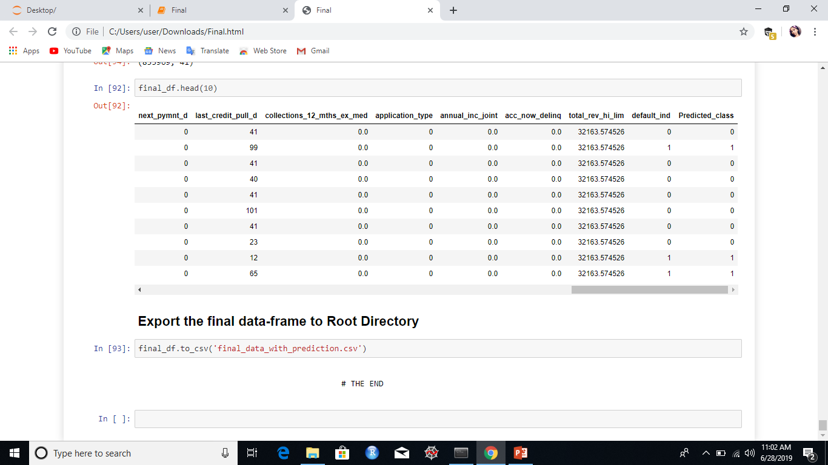
Final Prediction:
After comparing various models, the gradient boosting classifier (with tuning) is the best model so far.
Prediction on the whole dataset.

Slide 34
Conclusion:
The results of Neural Network and Gradient Boosting were the best among all.
If you want low type 1 error, use Neural Network.
If you want low type 2 error, use Gradient Boosting.
Type 2 error are actual losses for the company and type 1 error are failed profit.
As type 2 error is dangerous in our case, we preferred using Gradient Boosting.

Slide 35
THANK YOU

